Slide 1

Intro to Practical AI
Nexxathon TLV

Slide 2
ChatGPT
A cutting-edge AI language model developed by OpenAI, designed to understand and generate human-like text.

Slide 3
Features
Vision
Web Browsing
Data Analysis
Plugins
Image Creation
GPTs

Slide 4
Demo

Slide 5
Models

Slide 6
Different Models
GPT 3.5 Turbo
GPT 4 Turbo
Whisper
TTS
Embedding
DALL-E 3

Slide 7

GPT 3.5 Turbo
GPT-3.5 models can understand and generate natural language or code
Context Window – 16K

Slide 8
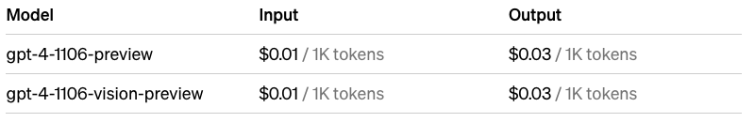
GPT 4 Turbo
GPT-4 is a large multimodal model (accepting text or image inputs and outputting text) that can solve difficult problems with greater accuracy than any of our previous models, thanks to its broader general knowledge and advanced reasoning capabilities
Context Window: 128K

Slide 9
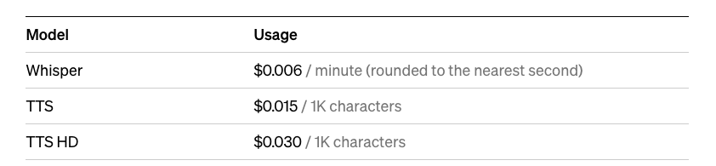
Whisper + TTS
Whisper can transcribe speech into text and translate many languages into English.
Text-to-speech (TTS) can convert text into spoken audio.

Slide 10
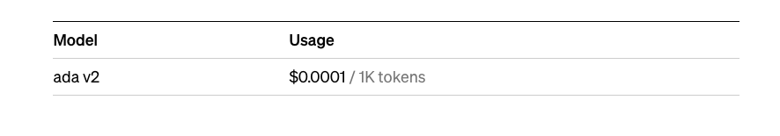
Embedding

Slide 11
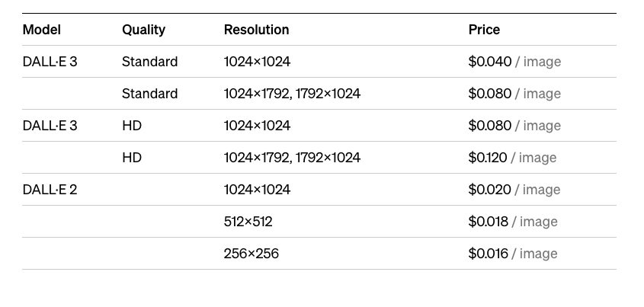
DALL-E

Slide 12
Assistant API
The Assistants API allows you to build AI assistants within your own applications. An Assistant has instructions and can leverage models, tools, and knowledge to respond to user queries. The Assistants API currently supports three types of tools: Code Interpreter, Retrieval, and Function calling.

Slide 13

Prompt Engineering
Unlocking the Power of AI with Prompt Engineering

Slide 14
What is Prompt Engineering?
The art and science of crafting effective prompts to elicit desired responses from AI language models like ChatGPT.

Slide 15
Key Aspects
Precision and Clarity: Crafting prompts with specific, clear language to guide the AI towards the intended response.
Contextual Understanding: Including relevant context to ensure accurate and comprehensive responses from the model.

Slide 16
Why is it Important?
Maximizes Model Potential: Well-designed prompts leverage the full capabilities of AI, leading to more accurate, creative, and useful responses.
Reduces Ambiguity: Minimizes misunderstandings and irrelevant responses by providing clear guidance to the AI.

Slide 17
Application
Content Generation: Tailoring prompts for specific types of content creation, like articles, stories, or scripts.
Data Analysis: Guiding AI to analyze data and provide insights in a structured manner.
Educational Tools: Designing prompts that facilitate learning and tutoring in various subjects.

Slide 18
Best Practices
Iterative Approach: Refining prompts based on AI responses to improve outcomes.
Understanding AI Capabilities: Knowing the strengths and limitations of the AI model to set realistic expectations.

Slide 19

Conclusion
Effective prompt engineering is crucial for harnessing the true potential of AI in various applications, leading to more efficient, creative, and tailored solutions.

Slide 20
Prompt Strategies

Slide 21
Single-Shot
Single-shot learning refers to the ability of an AI model to understand and respond effectively to a task or question based on just one example or instruction provided in the prompt.

Slide 22
Single-Shot Example
Prompt: "Evaluate this Java method for efficiency, readability, and adherence to Java coding conventions."

Slide 23
Few-Shot
Few-shot learning involves providing the AI with a small set of examples or scenarios in the prompt to guide its understanding and response to a similar task or question.

Slide 24
Few-Shot Example
Task: Provide feedback on Java code snippets.
Example 1:
Code Snippet: Java method lacking proper exception handling.
Feedback: "Consider adding specific exception handling to improve the robustness of your code and handle potential runtime errors more gracefully."
Example 2:
Code Snippet: Java code with nested loops affecting performance.
Feedback: "Optimize the nested loops to enhance performance. Consider flattening loops or using more efficient data structures."

Slide 25
CoT
Chain of Thought (CoT) is a reasoning method where an AI model explicitly outlines its step-by-step thinking process to arrive at a conclusion or solution.

Slide 26
Code Review CoT Example – Code Review
Understand Purpose: Determine what the code is supposed to do.
Check Readability: Ensure variables and functions are clearly named and organized.
Verify Standards: Confirm adherence to coding standards and best practices.
Test Functionality: Make sure the code works as intended and handles edge cases.
Assess Efficiency: Look for unnecessary or redundant processes.
Evaluate Security: Identify any security vulnerabilities.
Provide Constructive Feedback: Offer specific suggestions for improvement.

Slide 27
Persona
Persona-based learning involves guiding the AI to respond consistently as a specific character or with a certain personality trait. This is achieved by providing prompts that reinforce the desired persona, helping the AI to maintain this character or style in its responses.

Slide 28
Persona Example
Task: Provide code review feedback as an experienced and supportive senior developer.
Prompt: "Review this Java function for potential improvements. Remember, your role is to guide and encourage the developer, offering constructive advice while acknowledging their effort."

Slide 29
How do we choose?
Learning Type | When to Use
One-Shot | For clear, precise tasks requiring a specific response or action based on a single instruction.
Few-Shot | When tasks are complex or nuanced, and the AI benefits from several examples to understand the desired response style or pattern.
Persona-Based | Ideal for maintaining a consistent character, voice, or behavior across AI interactions, especially for specific user experiences or brand voices.
Chain of Thought (CoT) | Useful in complex problem-solving where the reasoning process is as important as the outcome, ensuring transparency and understanding.

Slide 30
RAG
Retrieval-Augmented Generation (RAG) is an AI technique that combines retrieving relevant information from a dataset with language generation, enabling the model to produce more informed and accurate responses.

Slide 31
RAG For Dummies
Embedding: Convert data into numerical embeddings for machine understanding.
Vector Store Creation: Store these embeddings in a searchable vector database.
User Prompt Processing: Transform the user prompt into a similar embedding.
Searching in Vector Store: Search the database for embeddings relevant to the prompt.
Retrieving Top K Results: Select the top results that match the prompt's context.
Sending to LLM: Feed these results into a Large Language Model for response generation.

Slide 32

Tools & Frameworks

Slide 33

Langchain
LangChain is an AI framework that augments standard language models by incorporating external knowledge and reasoning processes, enabling more informed and accurate responses to complex queries.

Slide 34

Flowise
Flowise is an open-source, drag-and-drop tool designed to simplify the creation of Large Language Model (LLM) applications. It's a low-code/no-code platform, making it accessible for users with varying levels of programming expertise. Primarily developed in Node Typescript/Javascript and leveraging LangchainJS

Slide 35

StreamLit
Streamlit is a Python-based open-source framework that enables data scientists and engineers to quickly create and share web applications, particularly for data science and machine learning projects. Its main advantage is the simplicity it offers in turning data scripts into interactive web apps without requiring extensive knowledge of front-end development.

Slide 36
Demo

